Slide 1
Our Lady of the Holy Family
First Meeting of the Parish Pastoral Council
Wednesday November 4, 2020

Slide 2
The Two Questions
1.How does my ministry make me a more vital and vibrant disciple of Jesus?
2. How is my ministry giving witness to the Kingdom of God in our parish community?

Slide 3
The Four Pillars of the Parish Pastoral Council
1. Hospitality (On Steroids)
2. Catholic Works of Mercy
3. Vibrant Celebration of Sunday Mass
4. Lifelong Catholic Formation and Education

Slide 4
Staff Liasons
Hospitality: Secretaries Grace Rubio and Diana Austin-Zuno
Catholic Works of Mercy: Deacon Larry Source
Vibrant Celebration of Sunday Mass: Director of Liturgical Music Catherine Foreman
Lifelong Catholic Formation and Education: Director of Lifelong Formation Theo McManigal

Slide 5
Hospitality (On Steroids)
“Greet all as you would greet Jesus. Welcome all as you would welcome Jesus. Be Jesus for those who do not know Him.”

Slide 6
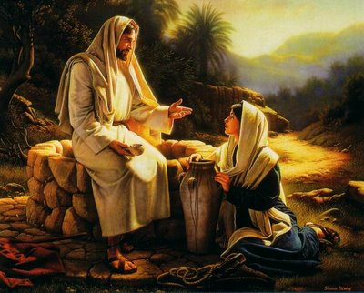
Hospitality (On Steroids)
Scriptural Benchmarks
Good Samaritan: Luke 10:25-3
Zacchaeus: Luke 19:1-10
The Woman at the Well: John 4: 1-42
The Stranger: Psalm146:9
This Photo by Unknown Author is licensed under CC BY-NC-ND

Slide 7
Hospitality (On Steroids)
Core Ministries and Responsibilities
1. Welcome at Sunday Mass (Pew Capitans)
2. Collect and Maintain Current Contact Information (Registration)
3. Share story of OLHF (Docent, Ambassador, Friend)

Slide 8
Catholic Works of Mercy
“The works of mercy are charitable actions by which we come to the aid of our neighbor in his spiritual and bodily necessities. Instructing, advising, consoling, comforting are spiritual works of mercy, as are forgiving and bearing wrongs patiently. The corporal works of mercy consist especially in feeding the hungry, sheltering the homeless, clothing the naked, visiting the sick and imprisoned, and burying the dead. Among all these, giving alms to the poor is one of the chief witnesses to fraternal charity: it is also a work of justice pleasing to God.” (Catechism of the Catholic Church 2447)

Slide 9
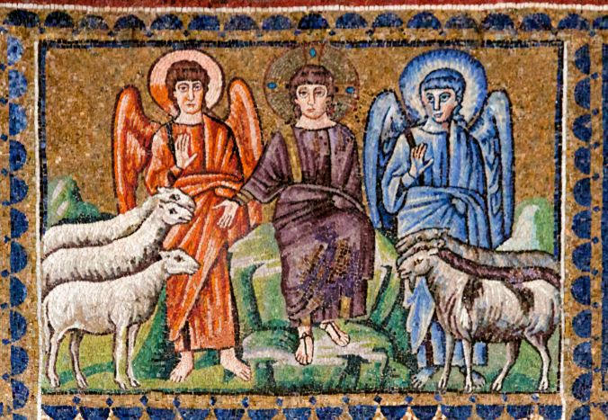
Catholic Works of Mercy
Scriptural Benchmarks
The Final Judgement: Matthew 25:31-42
Generous: Proverbs 22:9
Bury the Dead: Tobit 1:17-19
This Photo by Unknown Author is licensed under CC BY-NC-ND

Slide 10
Catholic Works of Mercy
Core Ministries and Responsibilities
Food Pantry
Ministry of Companionship and Consolation
Communion Visits to the Sick and Homebound

Slide 11
Vibrant Celebration of Sunday Mass
The Eucharist is the source and summit of the Christian life... For in the blessed Eucharist is contained the whole spiritual good of the Church, namely Christ Himself... By the Eucharistic celebration we already unite ourselves with the heavenly liturgy and anticipate eternal life... In brief, the Eucharist is the sum and summary of our faith. (CCC 1324-1327)

Slide 12
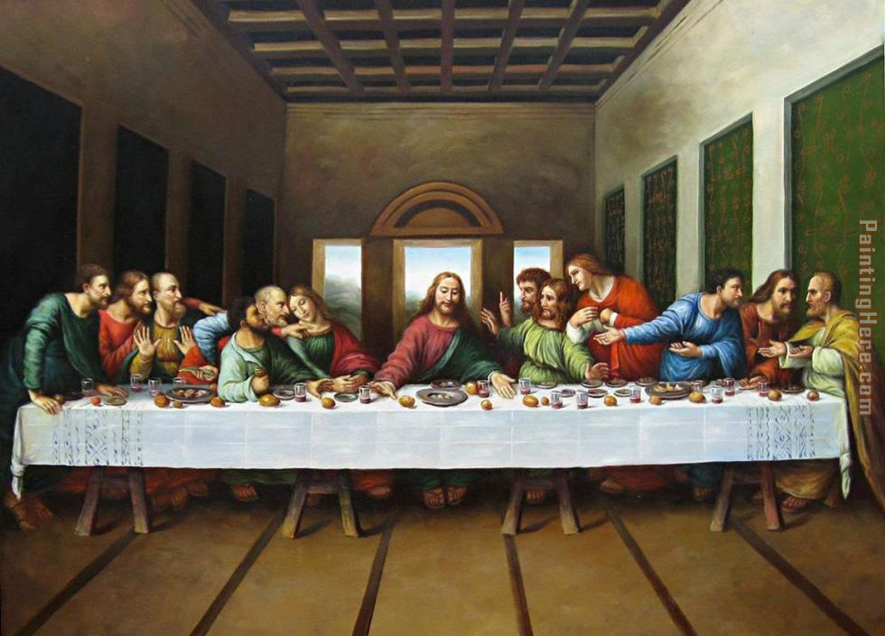
Vibrant Celebration of Sunday Mass
Scriptural Benchmarks
The Bread of Life Discourse: John 6:22-59
The Last Supper: Matthew 26:20; Mark 14:17; Luke 22:14-18
Celebrate: Exodus 12:14
This Photo by Unknown Author is licensed under CC BY-NC

Slide 13
Vibrant Celebration of Sunday Mass
Core Ministries and Responsibilities
Reconstitute Liturgy Committee
Scheduling Liturgical Year
Livestream of Sunday Mass

Slide 14
Lifelong Catholic Formation and Education
"Do not presuppose the faith but propose it...Faith is not maintained automatically. It is not "finished business" that we can simply take for granted. The life of faith has to be constantly renewed. And since faith is an act that comprehends all the dimensions of our existence, it also requires constantly renewed reflection and witness." Pope Benedict XVI in "Gospel, Catechesis, Catechism"
“Catholicism does not call us to abandon the world, but to help shape it. This does not mean leaving worldly tasks and responsibilities but transforming them.” (USCCB 1998 Pastoral Letter Everyday Christianity: To Hunger and Thirst for Justice)

Slide 15
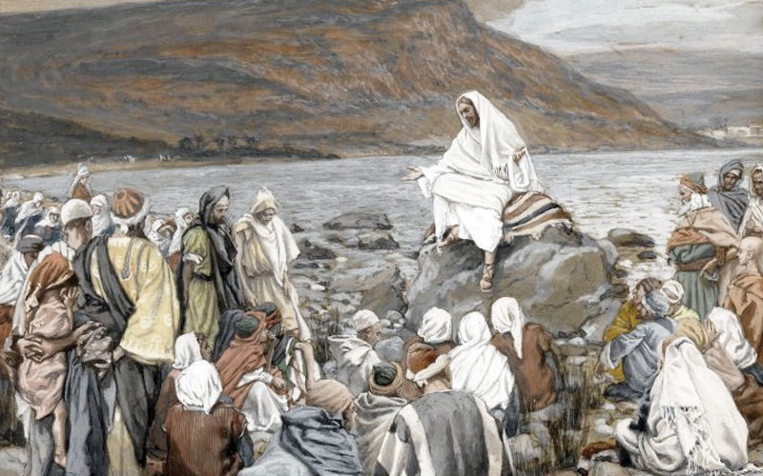
Lifelong Catholic Formation and Education
Scriptural Benchmarks
Scripture and Tradition:1 Corinthians 11:2, 2 Timothy 2:1-2
Faith and Works: James 2:17, Romans 2:13
This Photo by Unknown Author is licensed under CC BY-SA-NC

Slide 16
Lifelong Catholic Formation and Education
Core Ministries and Responsibilities
Sacramental Preparation for Children, Teens, and Adults
Bible Study and Engaged Catholic Formation for Parish
Alpha, Divine Renovation, Word on Fire

